Slide 1
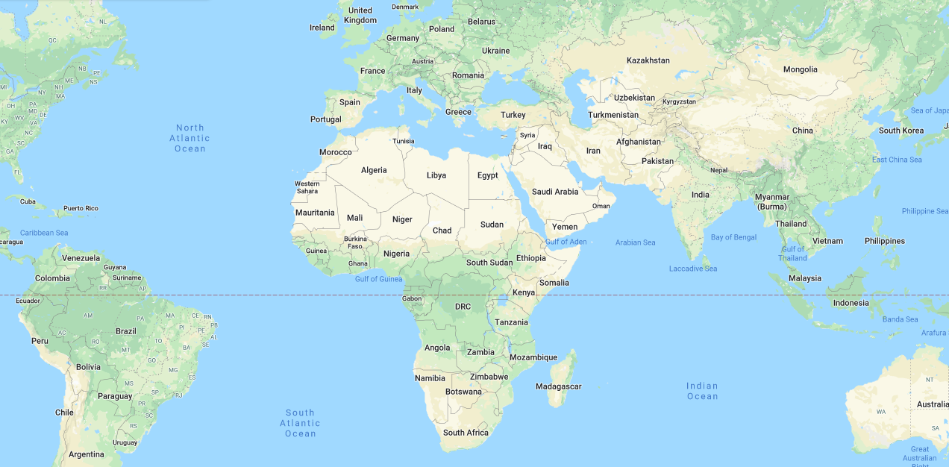

Global Radiation Oncology Analysis
Final Presentation
Shawna Tuli & Jessica George

Slide 2

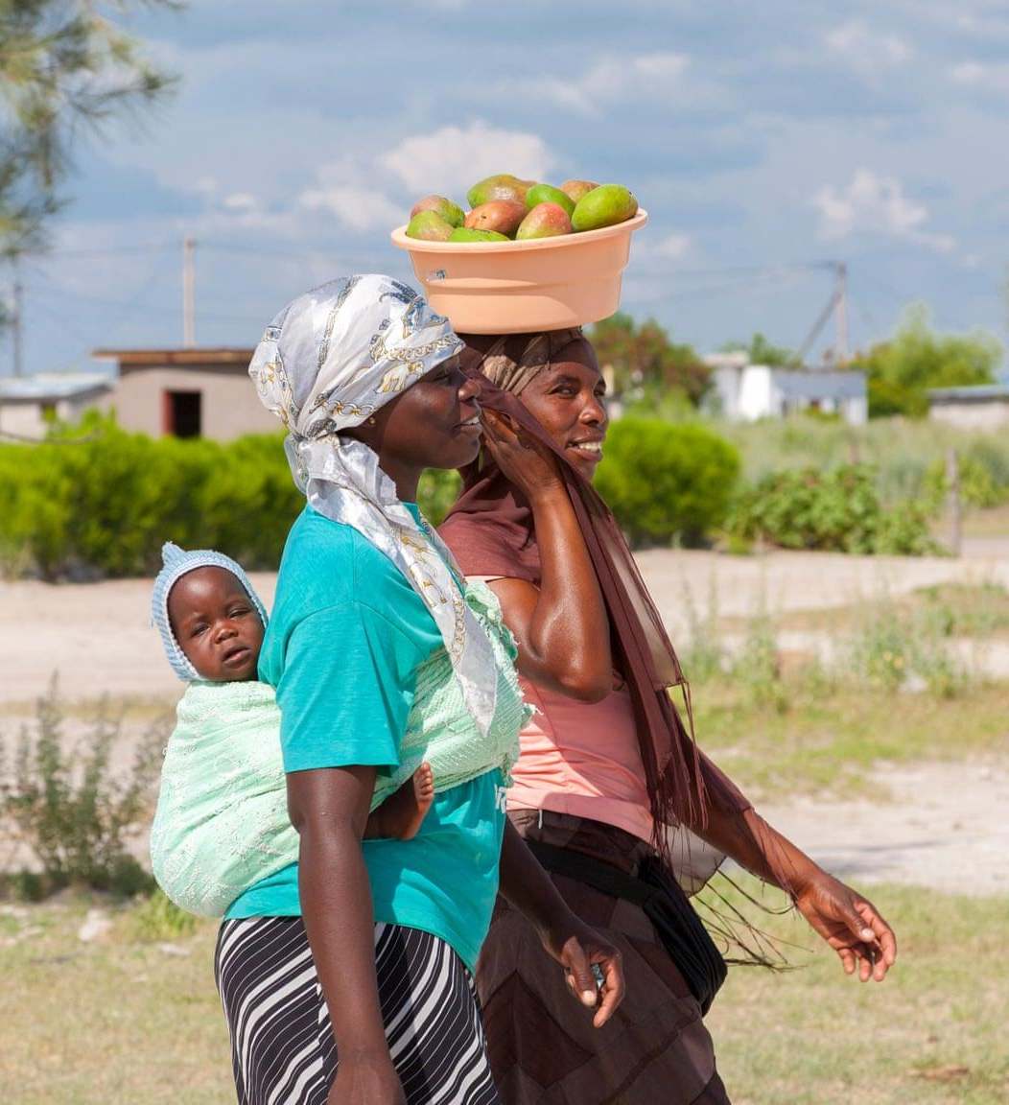
Summary
Background
Medical cohort of women in Botswana, Africa
Goal: To understand outcomes of patients with cervical cancer with or without HIV co-infection
Project
Analyze 7 years of survival data on 1,000 patients from this cohort
Summary | Experiments and Evaluation | Timeline
Notes:
Reference:
Project Proposal

Slide 3
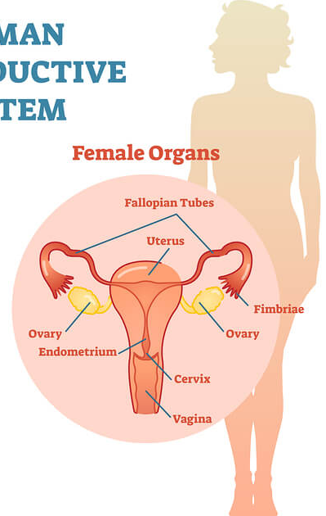
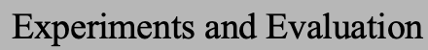
Medical Terminology: Cervical Cancer
Cancer that occurs in the cells of a woman’s cervix, i.e. lower part of the uterus that connects to the vagina
Treatment
Chemotherapy: kills or shrinks cancer with medicine (pills or administered through veins)
Radiation therapy: kills cancer with high-energy rays
What’s the difference? Chemotherapy delivers drugs to the entire body while radiation therapy aims to only target the area where the cancerous cells are.
Summary | Experiments adn Evaluation | Timeline
Notes:
Chemotherapy in study: Cisplatin
Radiation therapy in study: EBRT (External Beam Radiation Therapy), Brachytherapy, EQD2
Definitions:
https://www.mayoclinic.org/diseases-conditions/cervical-cancer/symptoms-causes/syc-20352501
https://www.hiv.gov/hiv-basics/overview/about-hiv-and-aids/what-are-hiv-and-aids
https://aidsinfo.nih.gov/understanding-hiv-aids/fact-sheets/21/51/hiv-treatment--the-basics
Photo:
https://files.aidsinfo.nih.gov/images/factsheet/HIV-Progression-800.jpg

Slide 4
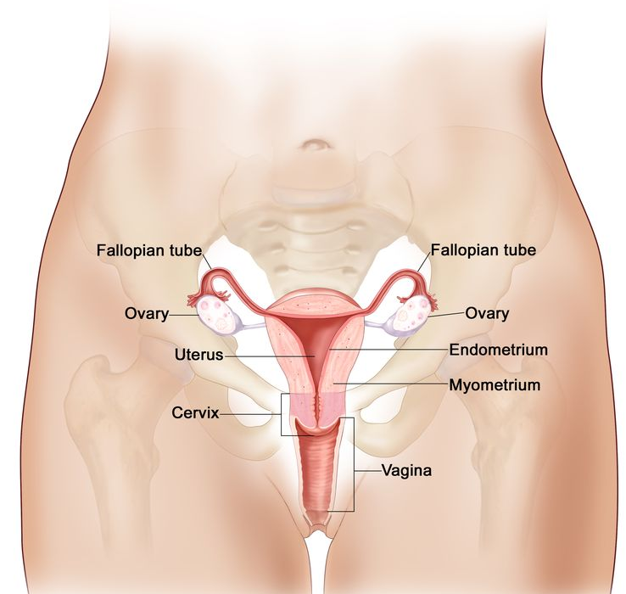
Medical Terminology: Cervical Cancer Stages
Stage I — Cancer has formed in the cervix only.
Stage II — Cancer has spread to the upper two-thirds of the vagina or to the tissue around the uterus.
Stage III — Cancer has spread to the lower third of the vagina and/or to the pelvic wall, and/or has caused kidney problems, and/or involves lymph nodes.
Stage IV — Cancer has spread beyond the pelvis, or has spread to the lining of the bladder or rectum, or has spread to other parts of the body.
Summary | Evaluation | Timeline
Notes:
Stage 1: Invasive carcinoma that is strictly confined to the cervix.
Stage 2: Locoregional spread of the cancer beyond the uterus but not to the pelvic sidewall or the lower third of the vagina.
Stage 3: Cancerous spread to the pelvic sidewall or the lower third of the vagina, and/or hydronephrosis or a nonfunctioning kidney that is incident to invasion of the ureter.
Stage 4: Cancerous spread beyond the true pelvis or into the mucosa of the bladder or rectum.
Majority of the patients in study are in stage 2.
Source:
https://www.cancer.gov/types/cervical/patient/cervical-treatment-pdq

Slide 5
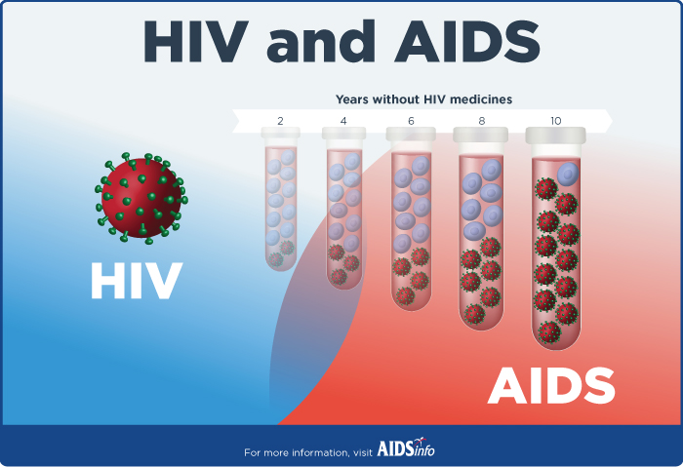
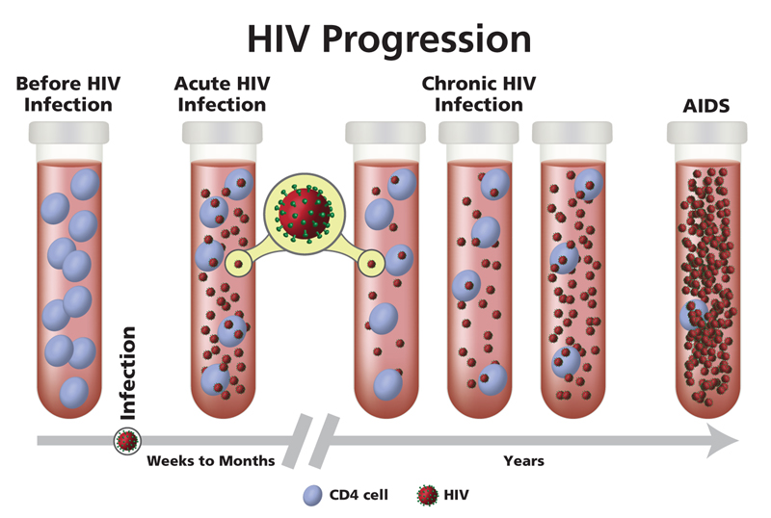
Medical Terminology: HIV/AIDS
HIV (Human Immunodeficiency Virus)
Virus that attacks cells which help the body fight infection
Which cells? CD4 cells
HIV Positive = person with HIV
HIV Negative = person without HIV
AIDS (Acquired Immunodeficiency Syndrome)
Final stage of HIV when the immune system is severely weak
ART (Antiretroviral Therapy)
Treatment involving taking a combination of HIV medicines
HIV Progression Loss of CD4 Cells
Summary | Evaluation | Timeline
Notes:
CD4 cells aka T-cells: white blood cells that help the body fight infection
Patient’s average CD4 count at the beginning of the study is 473, already below the average. (500-1500 on average)
ART cannot cure HIV but helps people live longer, healthier lives and reduces the risk of transmission.
AIDS (Acquired Immunodeficiency Syndrome) is the last stage of HIV infection which occurs when the body’s immune system is badly damaged due to the virus. ART can’t cure HIV, but HIV medicines help people with HIV live longer, healthier lives. ART also reduces the risk of HIV transmission.
Definitions:
https://www.mayoclinic.org/diseases-conditions/cervical-cancer/symptoms-causes/syc-20352501
https://www.hiv.gov/hiv-basics/overview/about-hiv-and-aids/what-are-hiv-and-aids
https://aidsinfo.nih.gov/understanding-hiv-aids/fact-sheets/21/51/hiv-treatment--the-basics
Photo:
https://www.viaglobalhealth.com/wp-content/uploads/2018/10/Platinum-Cardiology-Stethoscope-8.jpg

Slide 6
Data Collection
Data sets provided by Dr. Surbhi Grover in Radiation Oncology
Stata File 1 — Two years of patient data (182 patients; 2013-2015)
Stata File 2 — Five years of patient data (182 patients; 2013-2018)
Excel File 1 — Patient data for 2019 (182 patients)
Excel File 2 — Patient data for 2020 (182 patients)
Master CSV File — Full data set (1,000 patients; 2013-2020)
Topics covered about patients:
Personal Identification: omang ID, date of birth, geographical district
Medical Identification: age, height, weight, cancer stage, HIV status
Other: Dates, Chemotherapy, Radiation Therapy, HIV Medications, Blood Tests
Publishing in the International Journal of Radiation Oncology
Summary | Experiments and Evaluation | Timeline

Slide 7
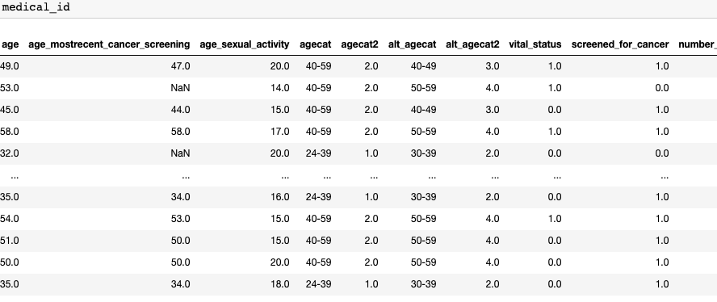
Data Wrangling
9 DataFrames for various topics based on medical definition mapping groupings
Personal Identification
Medical Identification
Treatment
Chemotherapy
Radiation Therapy
HIV Metrics
Symptoms
Blood
Mins and Maxes
Summary | Experiments and Evaluation | Timeline

Slide 8

Patient Information
Total patients in this study?
1,000 → 881 for running our models
Patients in each intial cancer stage?
Stage 1: 80 patients, Stage 2: 291 patients, Stage 3: 299 patients, Stage 4: 71 patients
Patients who are HIV positive or HIV negative?
HIV Negative: 249 patients, HIV Positive: 588 patients
Patient age groups?
20-29: 9 patients, 30-39: 166 patients, 40-49: 315 patients, 50-59: 162 patients,
60-69: 122 patients, 70-79: 57 patients, 80-89: 19, 90+: 1 patient
Summary | Experiments and Evaluation | Timeline

Slide 9
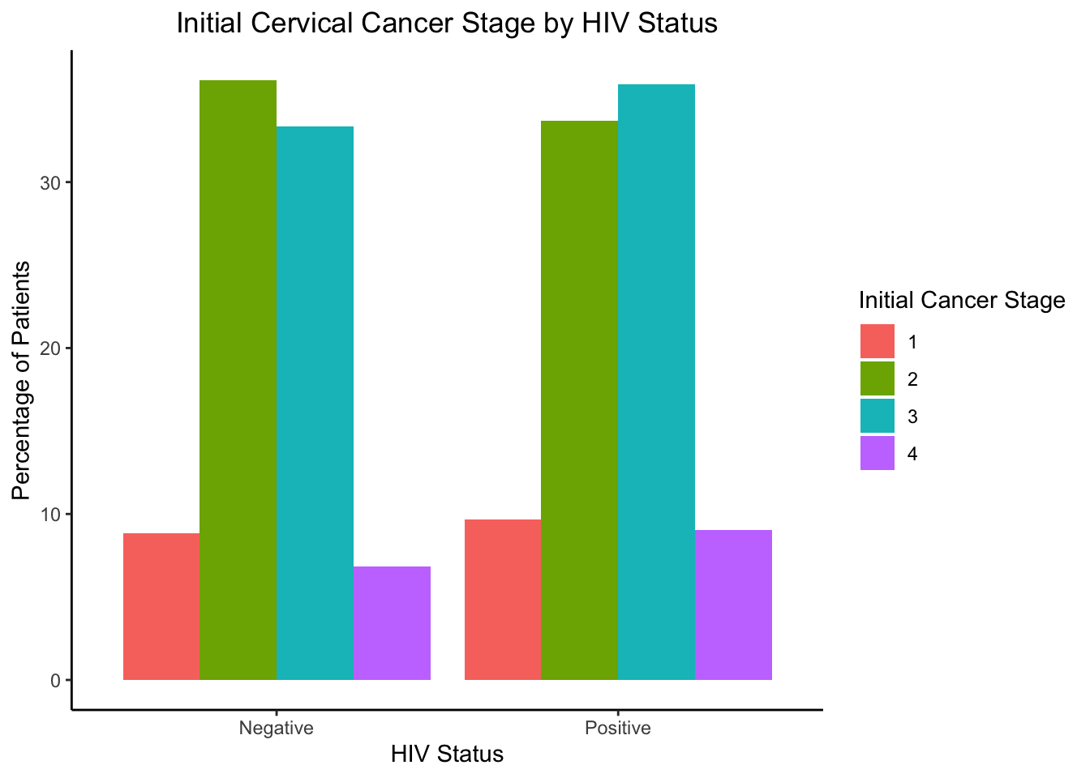
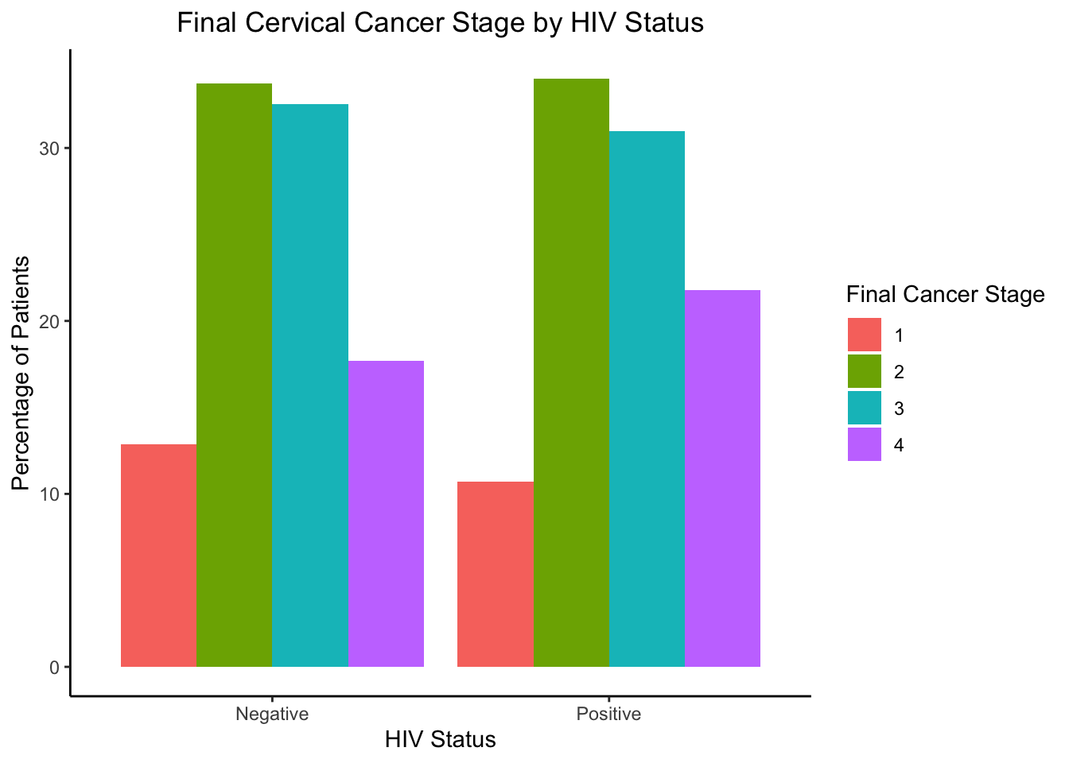
Exploratory Data Analysis I
Initial Versus Final Cancer Stage by HIV Status Patient Percentages
Summary | Experiments and Evaluation | Timeline

Slide 10
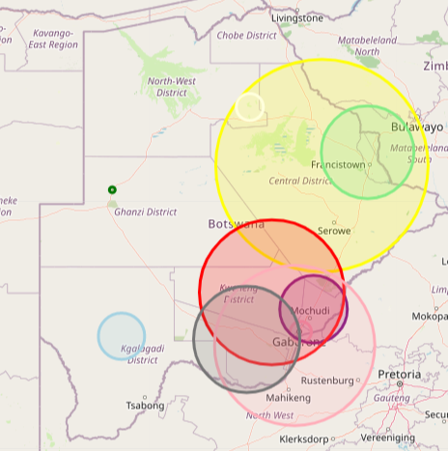
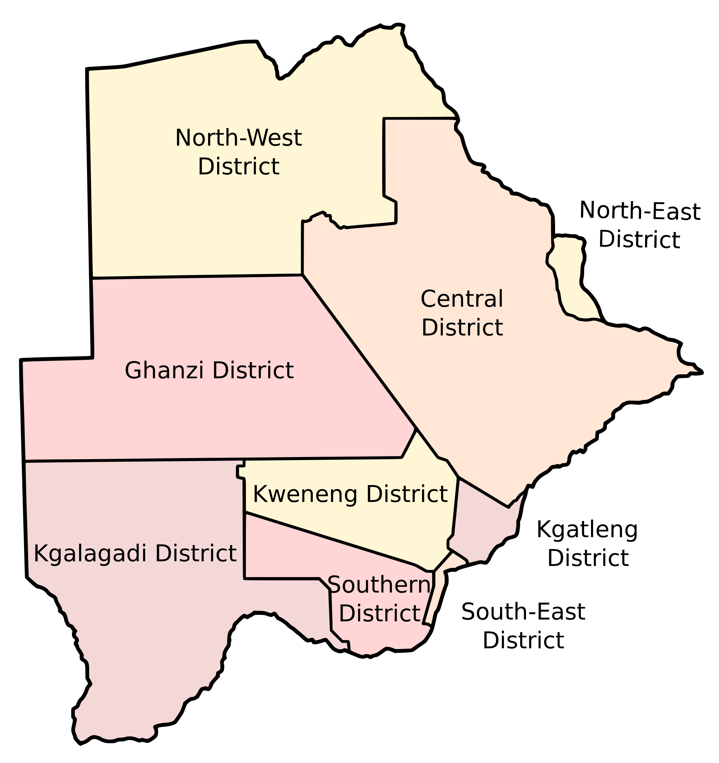
Exploratory Data Analysis II
Patients who have HIV by Botswana District
Summary | Experiments and Evaluation | Timeline
Notes:
Source:
http://gco.iarc.fr/today/data/factsheets/populations/72-botswana-fact-sheets.pdf
http://www.curemedicalglobal.com/6-types-of-cervical-cancer-treatment/
https://en.wikipedia.org/wiki/Districts_of_Botswana

Slide 11
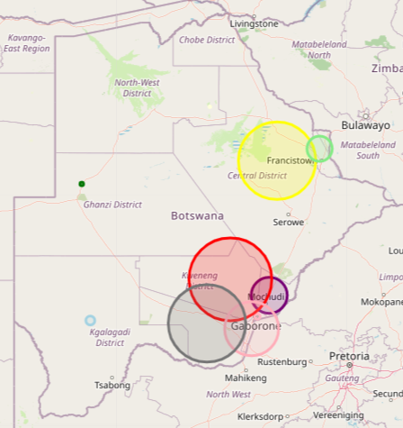
Exploratory Data Analysis III
Patients who do not have HIV by Botswana District
Summary | Experiments and Evaluation | Timeline
Notes:
Source:
http://gco.iarc.fr/today/data/factsheets/populations/72-botswana-fact-sheets.pdf
http://www.curemedicalglobal.com/6-types-of-cervical-cancer-treatment/
https://en.wikipedia.org/wiki/Districts_of_Botswana

Slide 12
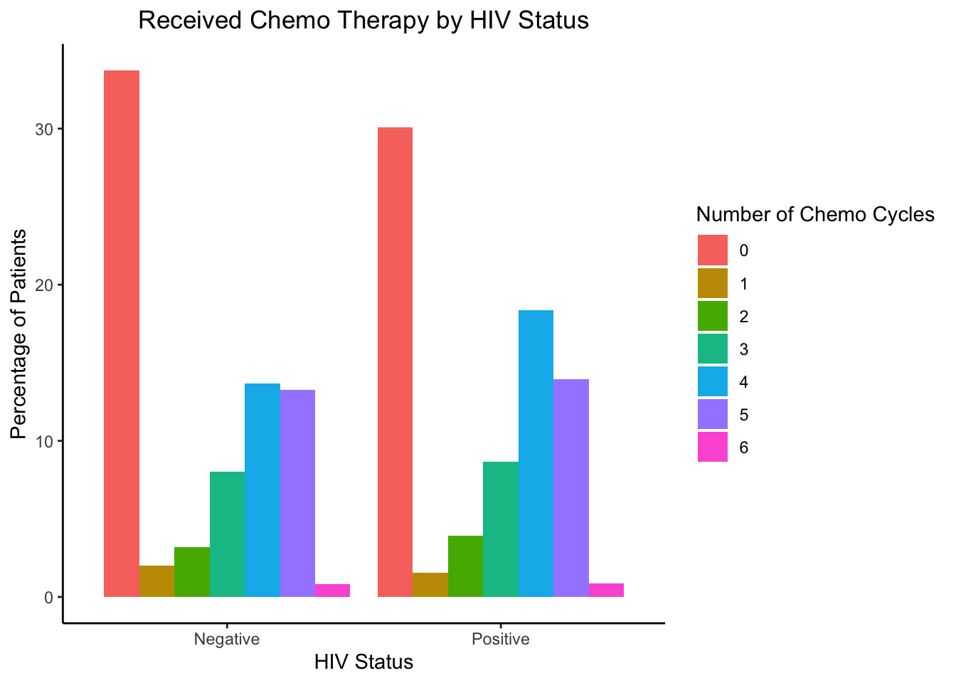
Exploratory Data Analysis IV
Chemotherapy Cycles by HIV Status Patient Percentages
Summary | Experiments and Evaluation | Timeline
Notes:
Fix labels on ggplot, legend labels, and order
Main takeaway: difference between these models is the response variable… shows that when years is the unit used, model performs the best
Fit GLM models -- doesn’t consider time or censoring but allows us to look at the response variable
Which unit of time is best for model accuracy?
AIC and BIC are measurements used to access model accuracy… will provide more context later with the actual models that we are interested in.
Source:
http://gco.iarc.fr/today/data/factsheets/populations/72-botswana-fact-sheets.pdf
http://www.curemedicalglobal.com/6-types-of-cervical-cancer-treatment/
https://en.wikipedia.org/wiki/Districts_of_Botswana

Slide 13
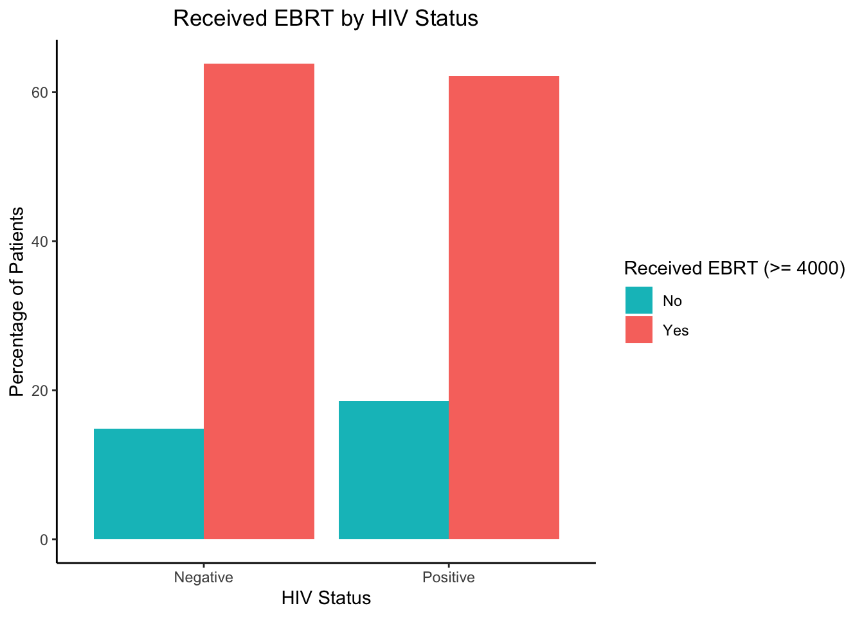
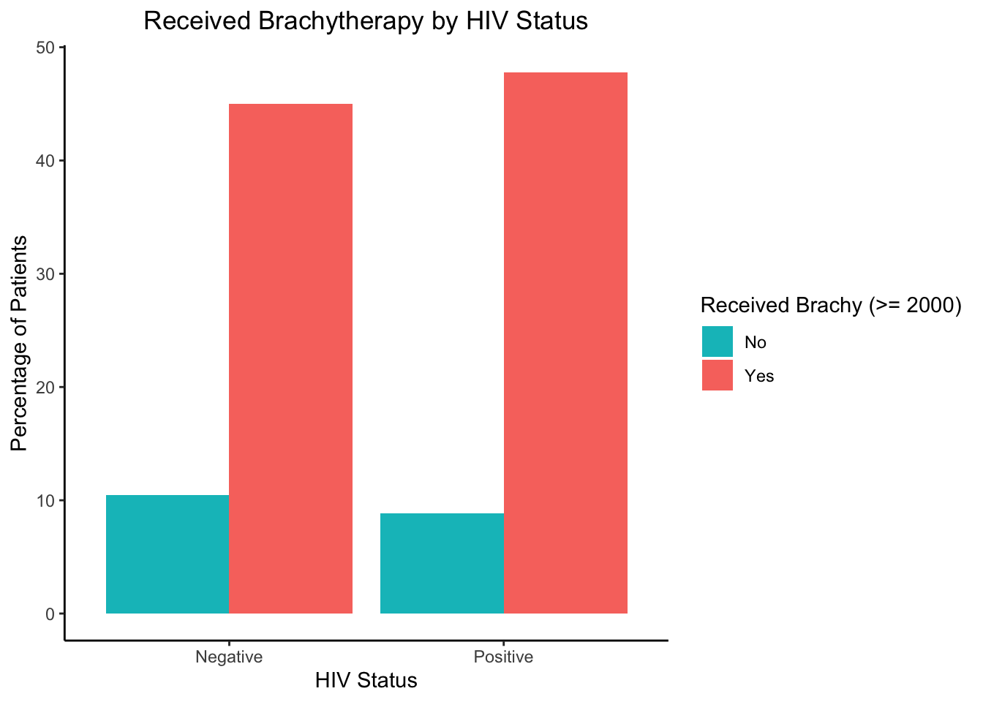
Exploratory Data Analysis V
Radiation Therapy by HIV Status Patient Percentages
Summary | Experiments and Evaluation | Timeline
Notes:
Fix labels on ggplot, legend labels, and order
Main takeaway: difference between these models is the response variable… shows that when years is the unit used, model performs the best
Fit GLM models -- doesn’t consider time or censoring but allows us to look at the response variable
Which unit of time is best for model accuracy?
AIC and BIC are measurements used to access model accuracy… will provide more context later with the actual models that we are interested in.
Source:
http://gco.iarc.fr/today/data/factsheets/populations/72-botswana-fact-sheets.pdf
http://www.curemedicalglobal.com/6-types-of-cervical-cancer-treatment/
https://en.wikipedia.org/wiki/Districts_of_Botswana

Slide 14
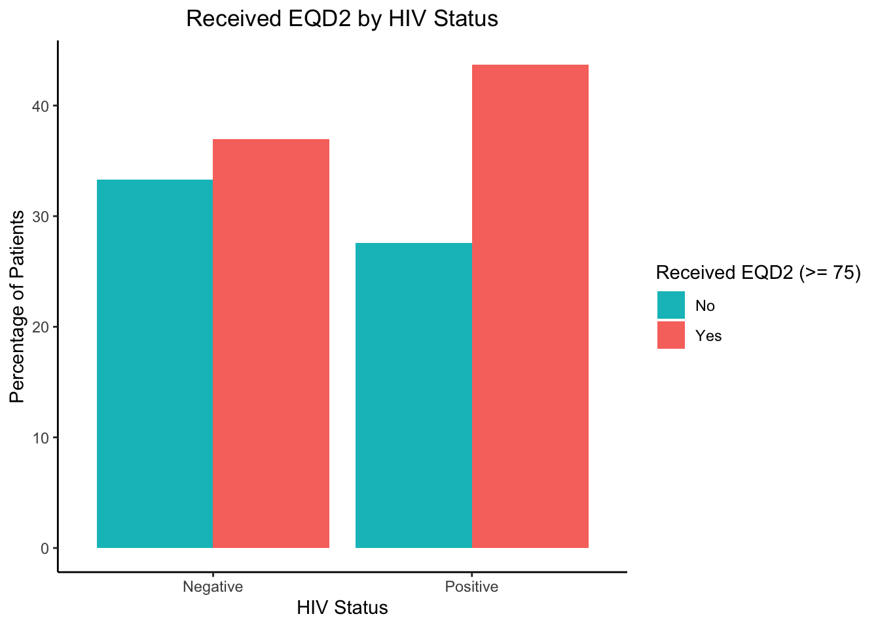
Exploratory Data Analysis V
Radiation Therapy by HIV Status Patient Percentages
Summary | Experiments and Evaluation | Timeline
Notes:
Fix labels on ggplot, legend labels, and order
Main takeaway: difference between these models is the response variable… shows that when years is the unit used, model performs the best
Fit GLM models -- doesn’t consider time or censoring but allows us to look at the response variable
Which unit of time is best for model accuracy?
AIC and BIC are measurements used to access model accuracy… will provide more context later with the actual models that we are interested in.
Source:
http://gco.iarc.fr/today/data/factsheets/populations/72-botswana-fact-sheets.pdf
http://www.curemedicalglobal.com/6-types-of-cervical-cancer-treatment/
https://en.wikipedia.org/wiki/Districts_of_Botswana

Slide 15
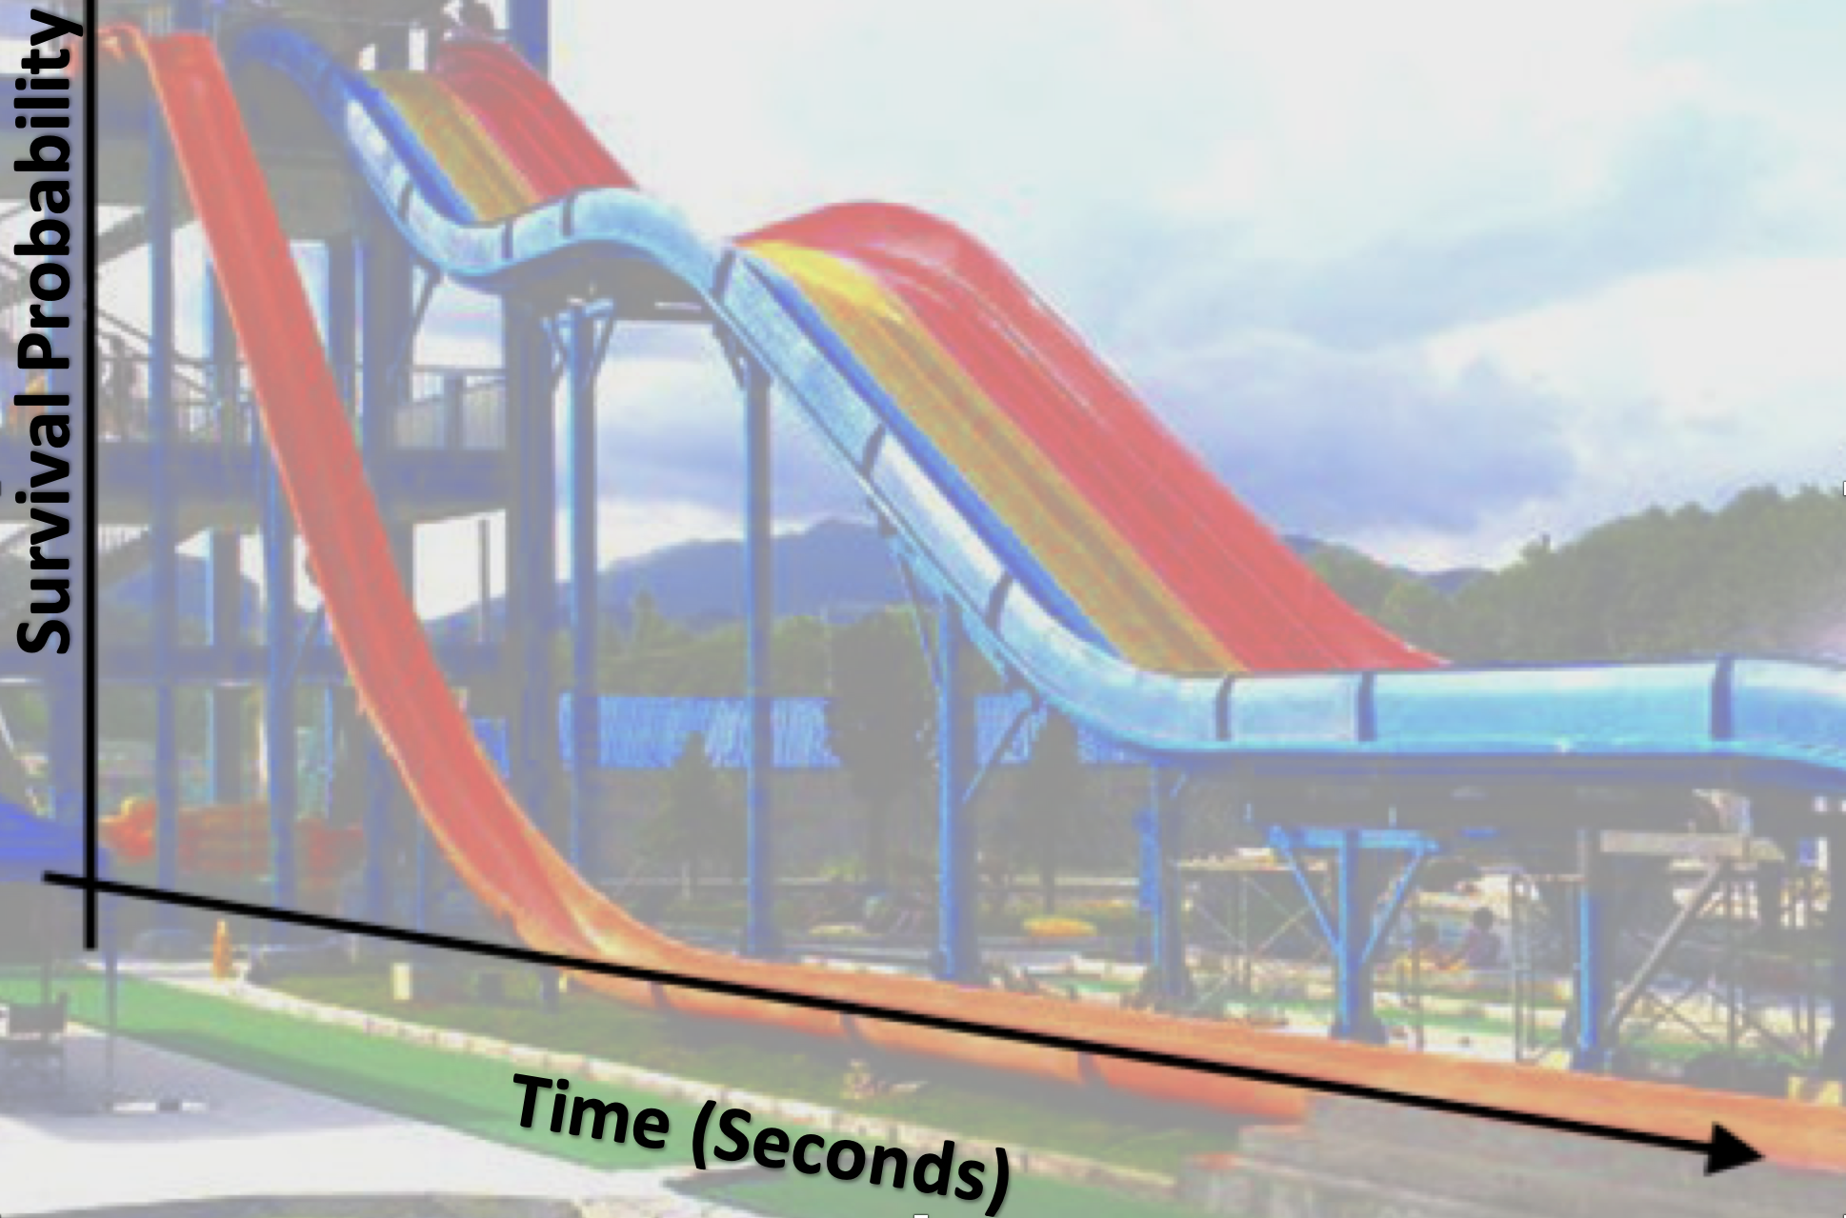
Survival Analysis
Used to estimate the time for an individual or a group of individuals to experience an event of interest, i.e death
Survival Time
Time starting from a predefined point to the occurrence of the event of interest
Censoring
Right Censoring: Not every member of the population experienced the event of interest
“End of Study Date” = 04/01/20
Summary | Experiments and Evaluation | Timeline
Notes:
Our time to event of interest: Death
Our Censoring: Their survival times are longer than their time in the study.
Source:
https://towardsdatascience.com/survival-analysis-part-a-70213df21c2e

Slide 16
Kaplan-Meier and Log Rank Test
Kaplan-Meier Estimate
Used to measure the fraction of subjects who survived for a certain amount of survival time under the same circumstances
Kaplan-Meier Survival Curve
The probability of surviving in a given length of time where time is considered in small intervals, i.e years
Log Rank Test
Compares survival curves between two or more independent groups
Statistical hypothesis test that tests the null hypothesis that survival curves of two populations do not differ
Summary | Experiments and Evaluation | Timeline
Notes:
Source:
https://towardsdatascience.com/survival-analysis-part-a-70213df21c2e

Slide 17
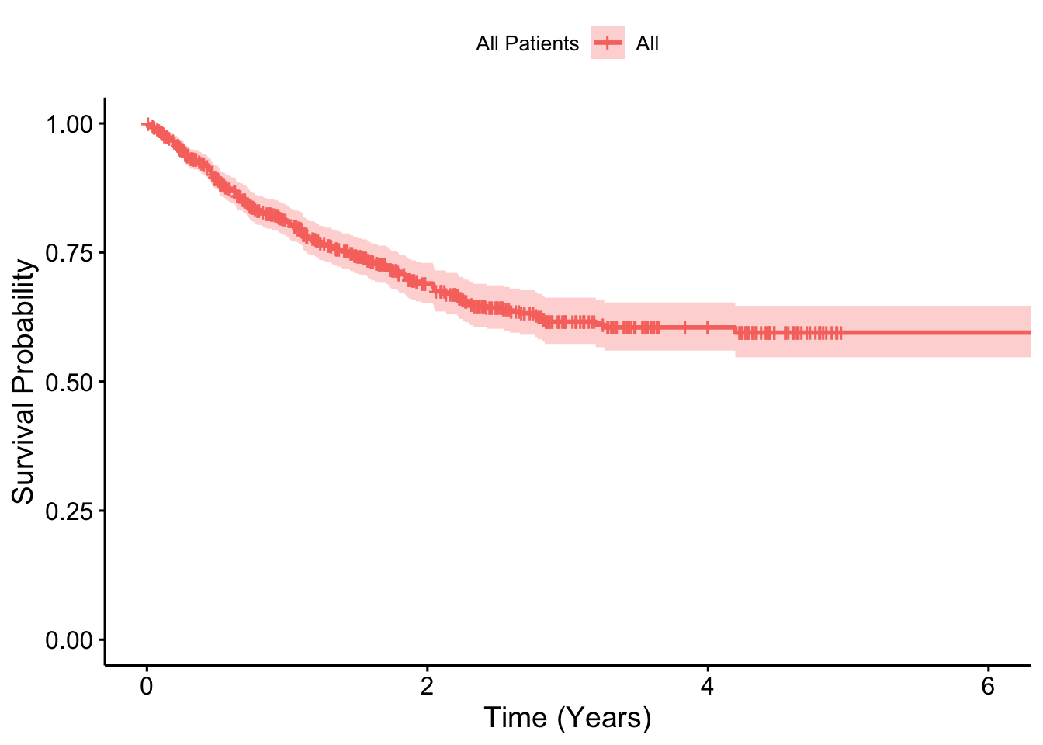
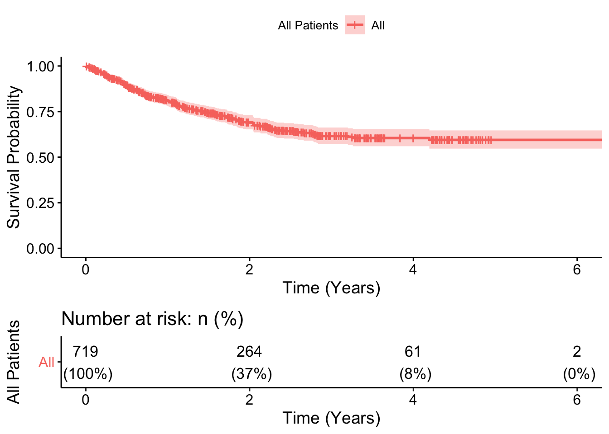
Kaplan-Meier Estimate I
Patient Survival Probability
Summary | Experiments and Evaluation | Timeline

Slide 18
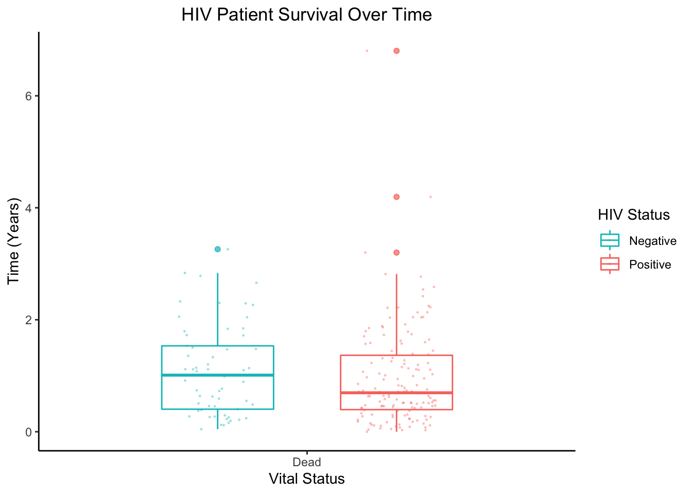
Patient Survival Times by HIV Status
Summary | Experiments and Evaluation | Timeline
Notes:
Call:
survdiff(formula = Surv(time_alive1, vital_status) ~ hiv_status,
data = data)
N Observed Expected (O-E)^2/E (O-E)^2/V
hiv_status=0 60 18 25.3 2.10 3.26
hiv_status=1 121 54 46.7 1.14 3.26
Chisq= 3.3 on 1 degrees of freedom, p= 0.07

Slide 19
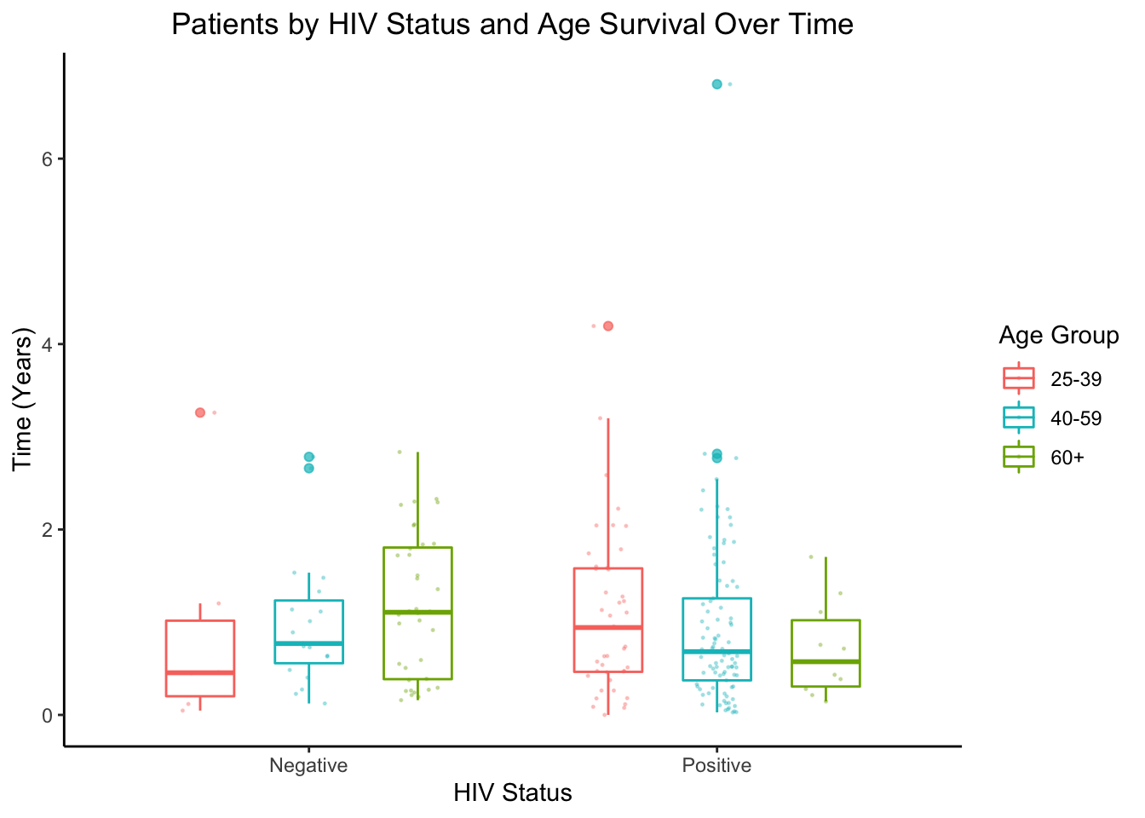

Patient Survival Times by HIV Status and Age of 25-39, 40-59, 60+
Summary | Evaluation | Timeline

Slide 20
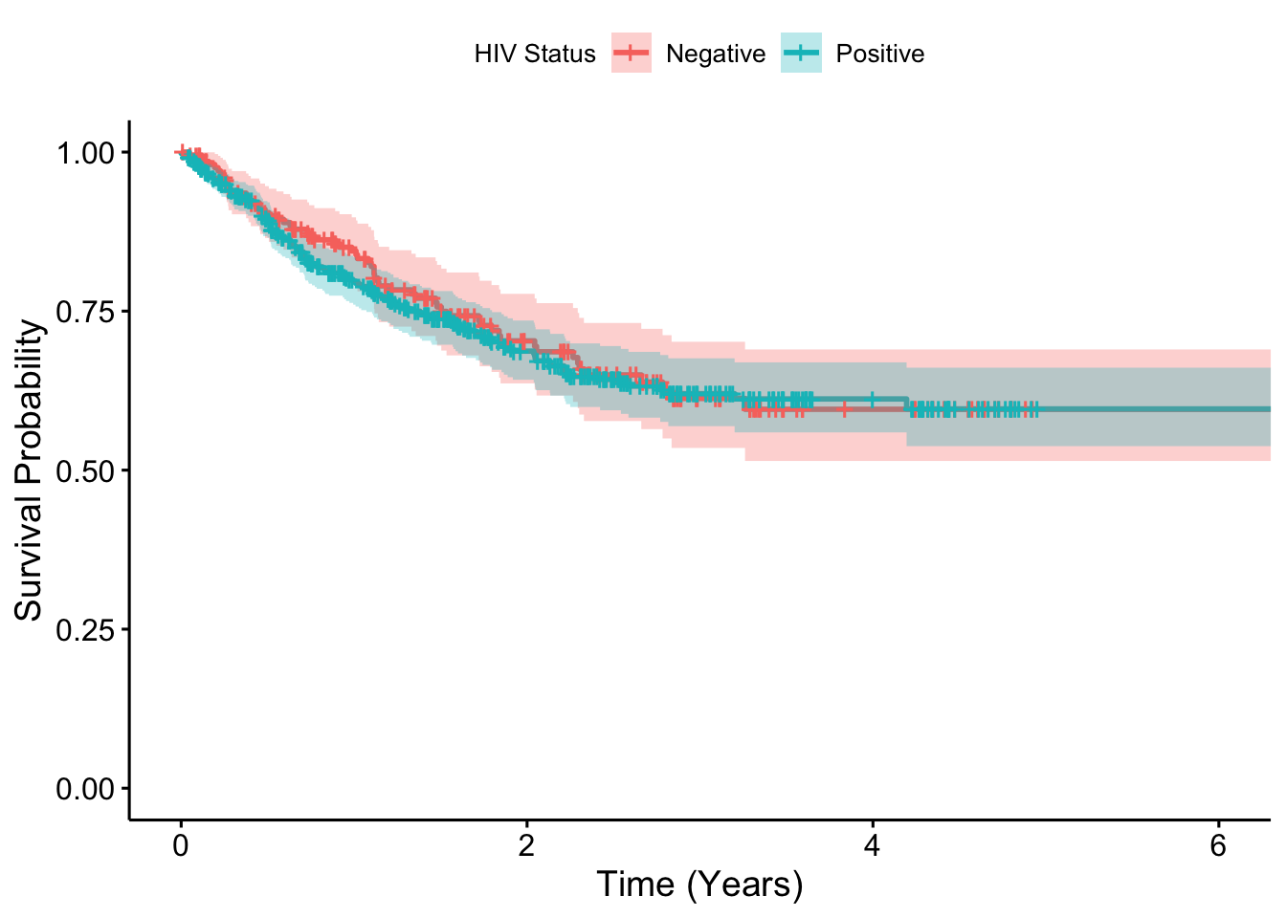
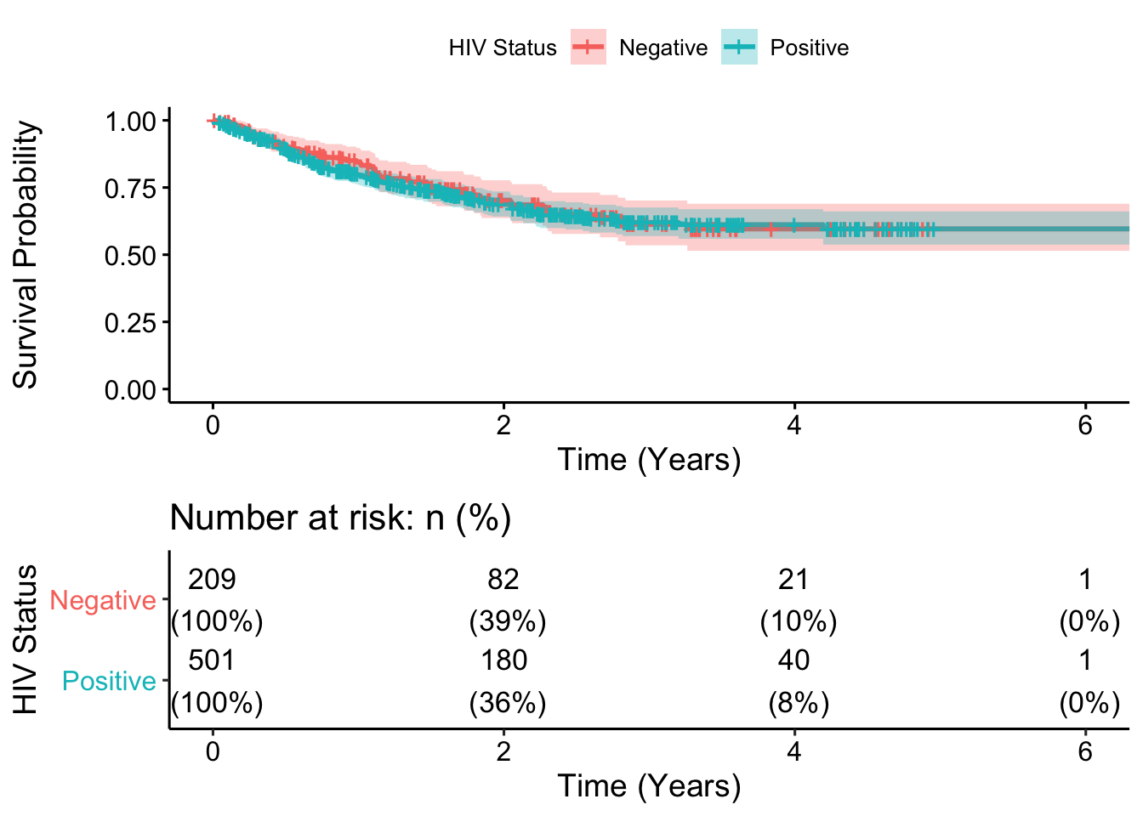
Kaplan-Meier Estimate II
Patients by HIV Status Survival Probability
Summary | Experiments and Evaluation | Timeline
Notes:
Sources:
http://gco.iarc.fr/today/data/factsheets/populations/72-botswana-fact-sheets.pdf, http://www.curemedicalglobal.com/6-types-of-cervical-cancer-treatment/
https://en.wikipedia.org/wiki/Districts_of_Botswana

Slide 21
Log Rank Test on Patient HIV Status
H₀: The two survival curves are identical (S_{HIV-Positive} = S_{HIV-Negative}).
H_{a}: The two survival curves are not identical (S_{HIV-Positive} ≠ S_{HIV-Negative} at any time t).
Asymptotic Two-Sample Log Rank Test
Model: Surv(time_alive_years, vital_status) by hiv_status)
z = 1.1358, p-value = 0.256
Interpretation
Since the p-value (0.256) is greater than 0.05, we fail to reject the null hypothesis that the two survival curves are identical (S_{HIV-Positive} = S_{HIV-Negative}).
Summary | Experiments and Evaluation | Timeline

Slide 22
Cox Proportional Hazards Regression Model
Builds a survival function with multiple risk factors which tells the probability a certain event (e.g. death) happens at a particular time t
Hazard ratio (HR): measure of an effect of an intervention on an outcome of interest over time
Interpreting the model coefficients in terms of HR
If negative, HR decreases: Reduction in the hazard → Positively associated with patient survival
If 0, HR = 1: No effect
If positive, HR increases → Negatively associated with patient survival
Summary | Experiments and Evaluation | Timeline
Notes:
Assumption of the hazard ratio is that it is proportional

Slide 23
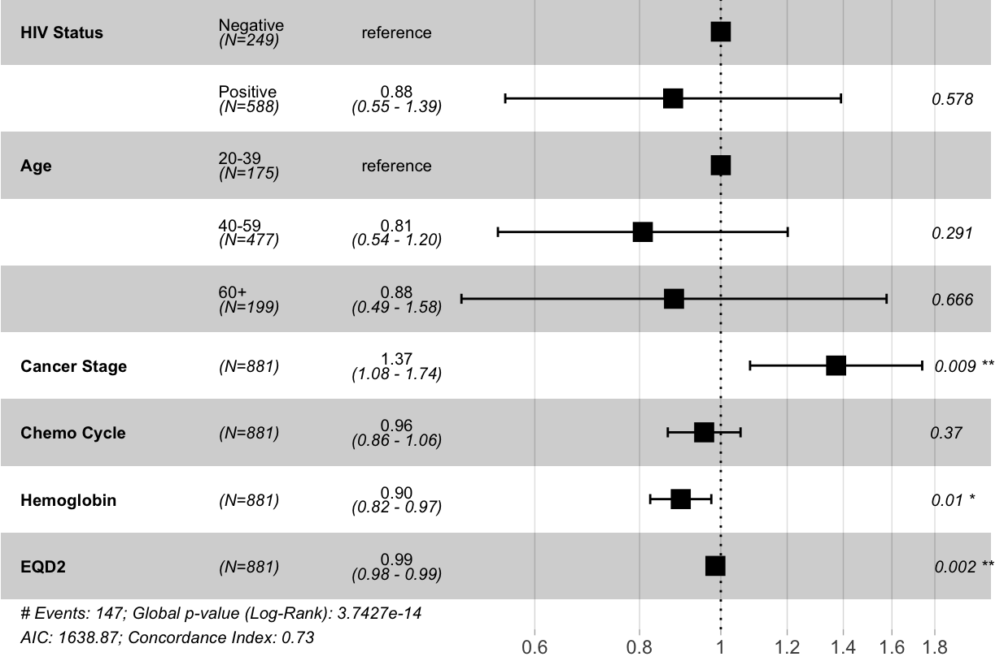
Model 1
Multivariate Cox Proportional Hazards Regression: Fit a cox regression model with more than one factor
Model 1: Surv(time_alive_years, vital_status) ~ HIV Status + Age + Cancer Stage + Chemo Cycles + HB_rt + EQD2_df
Summary | Experiments and Evaluation | Timeline
Notes:
Call:
coxph(formula = SurvObj ~ agecat2, data = data)
coef exp(coef) se(coef) z p
agecat2 0.2134 1.2379 0.1826 1.169 0.243
Likelihood ratio test=1.36 on 1 df, p=0.2435
n= 182, number of events= 73
Call:
coxph(formula = SurvObj ~ alt_agecat2, data = data)
coef exp(coef) se(coef) z p
alt_agecat2 0.1057 1.1115 0.1002 1.055 0.292
Likelihood ratio test=1.09 on 1 df, p=0.2965
n= 182, number of events= 73

Slide 24
Multivariate Cox with Interaction
Interaction: Occurs when an independent variable has a different effect on the outcome depending on the values of another independent variable
Model: Response is Surv(time_alive_years, vital_status)
Covariates: ~ HIV Status + Age + Cancer Stage + Chemo Cycles + HB (>10) + EQD2 (>75)
Interaction Terms Tested with the Model:
Age and Cancer Stage,
HIV Status and Cancer Stage,
HIV Status and Chemo Cycles,
Chemo and EQD2,
HIV Status and EQD2,
Cancer Stage and EQD2
Summary | Experiments and Evaluation | Timeline
Notes:
https://medium.com/@analyttica/what-is-bayesian-information-criterion-bic-b3396a894be6

Slide 25
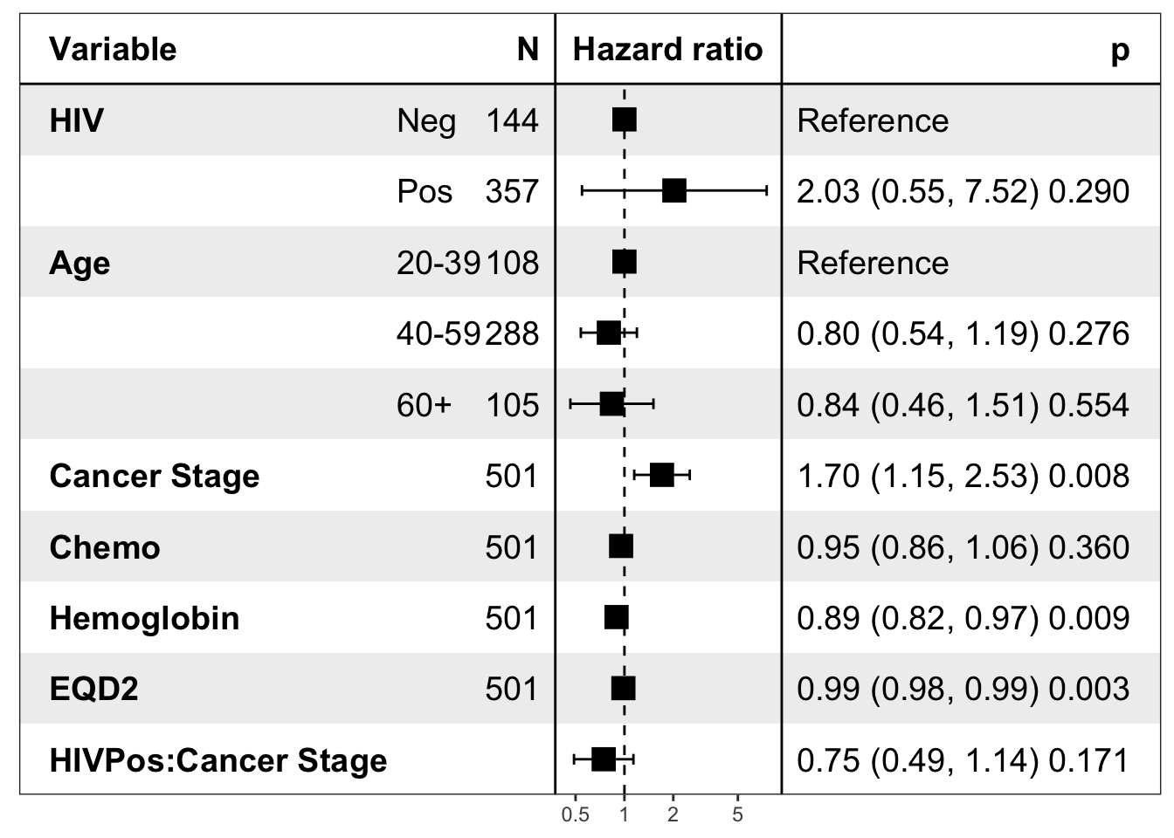
Model 2
Multivariate Cox Proportional Hazards Regression with Interaction
Model 2: Surv(time_alive_years, vital_status) ~ HIV Status + Age + Cancer Stage + Chemo Cycles + HB_rt + EQD2_df +
(HIV Status*Cancer Stage)
Summary | Experiments and Evaluation | Timeline
Notes:
https://medium.com/@analyttica/what-is-bayesian-information-criterion-bic-b3396a894be6

Slide 26
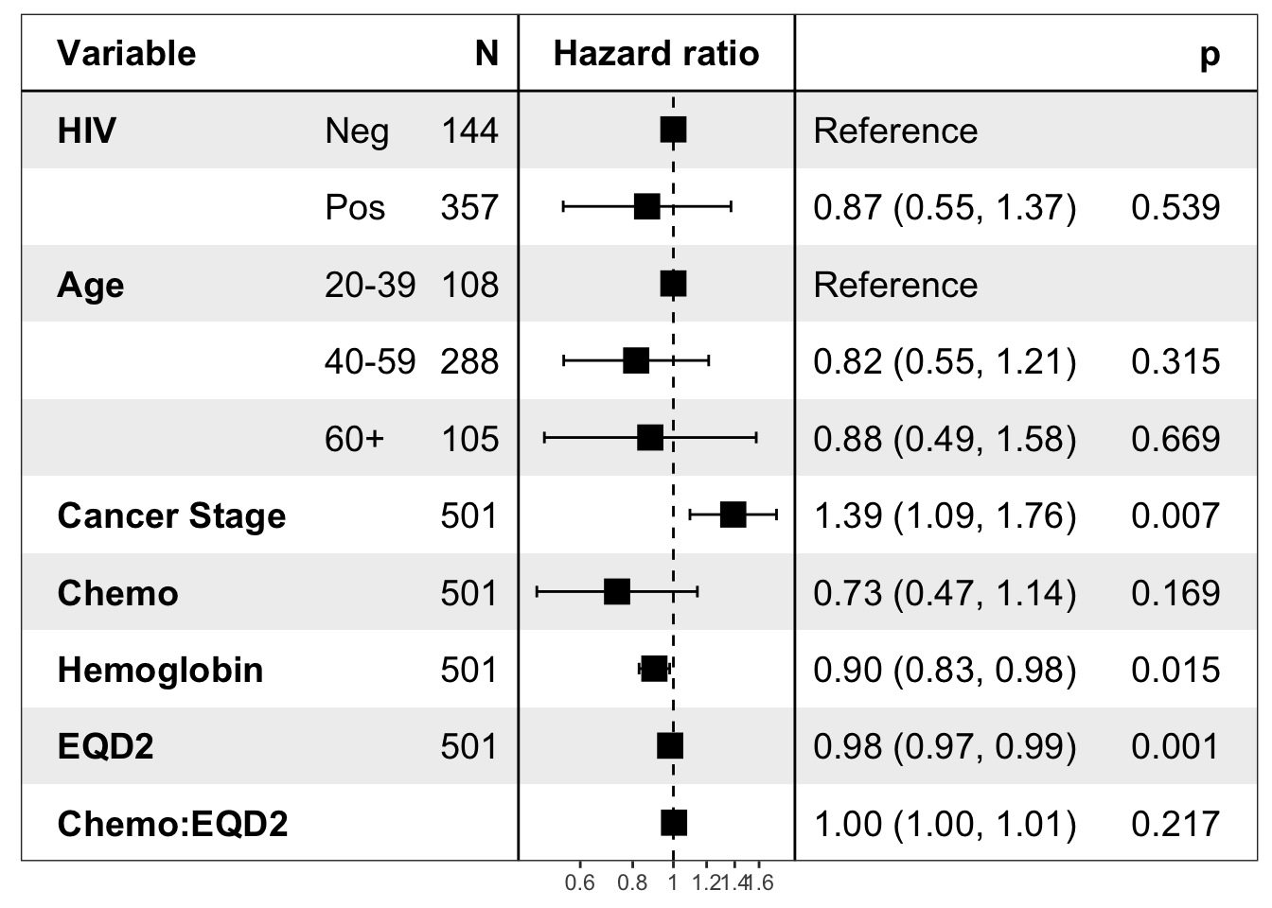
Model 3
Multivariate Cox Proportional Hazards Regression with Interaction
Model 3: Surv(time_alive_years, vital_status) ~ HIV Status + Age + Cancer Stage + Chemo Cycles + HB_rt + EQD2_df +
(Chemo Cycles * EQD2_df)
Summary | Experiments and Evaluation | Timeline
Notes:
https://medium.com/@analyttica/what-is-bayesian-information-criterion-bic-b3396a894be6

Slide 27
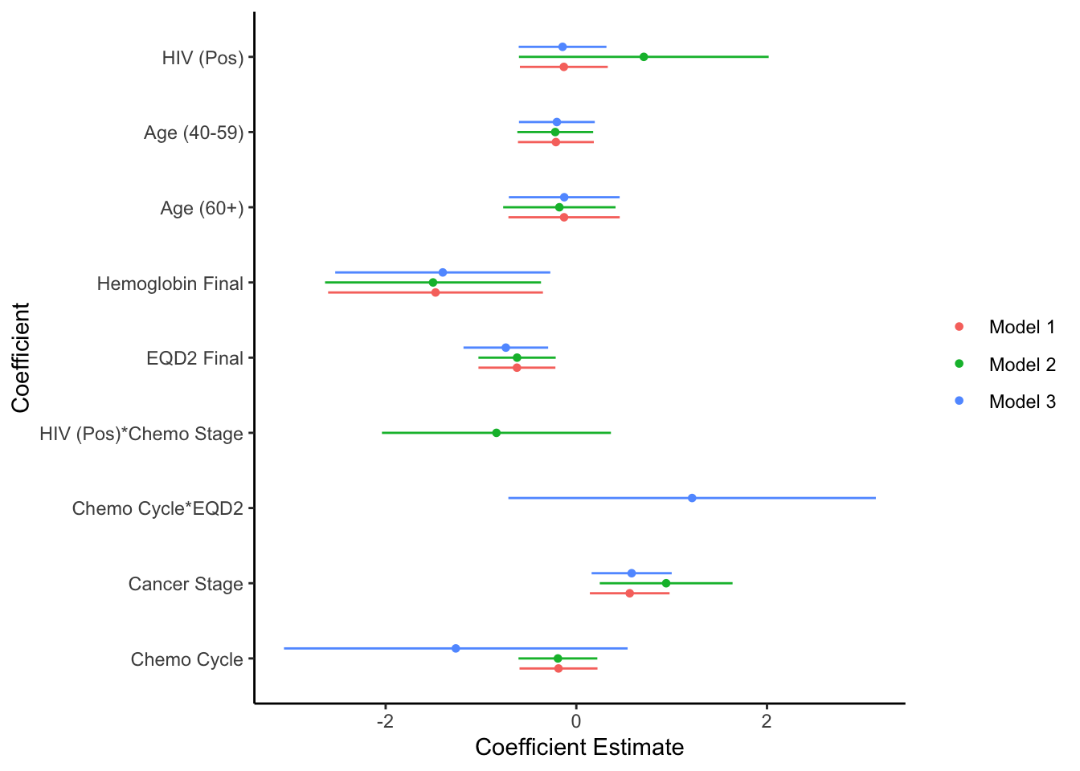
Multivariate Model Coefficient Comparisons
Summary | Experiments and Evaluation | Timeline
Notes:
Call:
coxph(formula = SurvObj ~ agecat2, data = data)
coef exp(coef) se(coef) z p
agecat2 0.2134 1.2379 0.1826 1.169 0.243
Likelihood ratio test=1.36 on 1 df, p=0.2435
n= 182, number of events= 73
Call:
coxph(formula = SurvObj ~ alt_agecat2, data = data)
coef exp(coef) se(coef) z p
alt_agecat2 0.1057 1.1115 0.1002 1.055 0.292
Likelihood ratio test=1.09 on 1 df, p=0.2965
n= 182, number of events= 73

Slide 28
Model Assessment: Model 1 vs. Model 2 vs. Model 3
BIC (Bayesian Information Criterion): Introduces a penalty term for the number of parameters in the model; Penalty term larger in BIC than in AIC
Model with lower BIC score = lower penalty terms = better model
BIC between Multivariate Cox Regression Models
Cox Models: Response is Surv(time_alive_years, vital_status)
Model 1: ~ HIV Status + Age + Cancer Stage + Chemo Cycles + HB_bt + EQD2_df
Model 2: ~ HIV Status + Age + Cancer Stage + Chemo Cycles + HB_rt + EQD2_df +
(HIV Status*Cancer Stage)
Model 3: ~ HIV Status + Age + Cancer Stage + Chemo Cycles + HB_rt + EQD2_df +
(Chemo Cycles*EQD2)
According to BIC, Model 1 < Model 2 < Model 3 (1659.803 < 1662.913 < 1663.089)
Summary | Experiments and Evaluation | Timeline
Notes:
https://medium.com/@analyttica/what-is-bayesian-information-criterion-bic-b3396a894be6

Slide 29
Model Assessment: Model 1 vs. Model 2 vs. Model 3
AIC (Akaike Information Criterion): Lets you test how well your model fits the data set without overfitting it
Model with the lower AIC score = balance between ability to fit and ability to avoid overfitting
AIC between Multivariate Cox Regression Models
Cox Models: Response is Surv(time_alive_years, vital_status)
Model 1: ~ HIV Status + Age + Cancer Stage + Chemo Cycles + HB_bt + EQD2_df
Model 2: ~ HIV Status + Age + Cancer Stage + Chemo Cycles + HB_rt + EQD2_df +
(HIV Status*Cancer Stage)
Model 3: ~ HIV Status + Age + Cancer Stage + Chemo Cycles + HB_rt + EQD2_df +
(Chemo Cycles*EQD2)
According to AIC, Model 1 < Model 2 < Model 3 (1638.87 < 1638.99 < 1639.166)
Summary | Experiments and Evaluation | Timeline
Notes:
Source:
https://towardsdatascience.com/the-akaike-information-criterion-c20c8fd832f2

Slide 30
Random Forests Ensemble Model
Random Forest Ensemble Model: Uses bagging as the ensemble method and decision tree as the individual model
Bagging: Training a bunch of individual models in a parallel way. Each model is trained by a random subset of the data
Basic Interpretation: Predicts individual patient’s survival curve
Benefits:
Fully nonparametric
Robust to outliers and does not suffer from a convergence problem
Can be used for high-dimensional data
Offers OOB (cross-validated) prediction that does not overfit the data
Provides a fully nonparametric VIMP measure of a variables’ contribution to predicting survival
Summary | Experiments and Evaluation | Timeline
Notes:
Source:
https://medium.com/@analyttica/what-is-bayesian-information-criterion-bic-b3396a894be6
Fully non-parametric: can identify survival risk factors without assuming parametric relationship (linear or nonlinear) or prior knowledge of interactions among variables

Slide 31
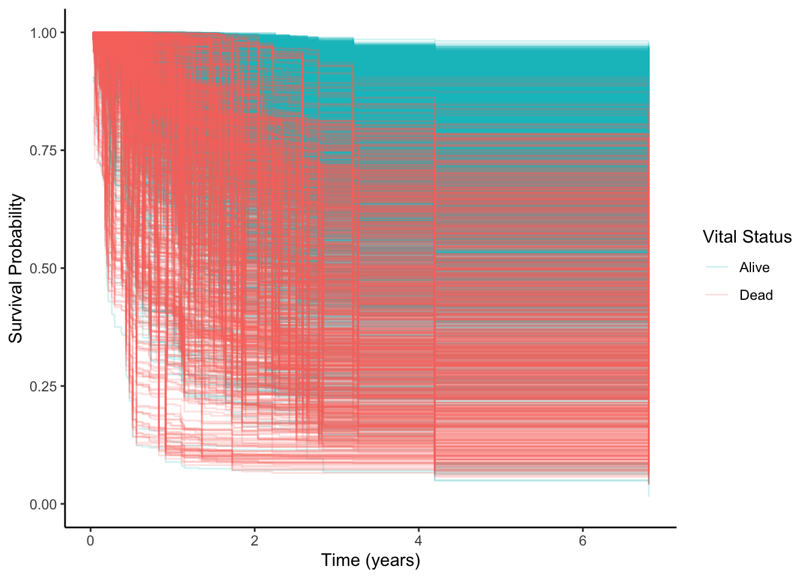
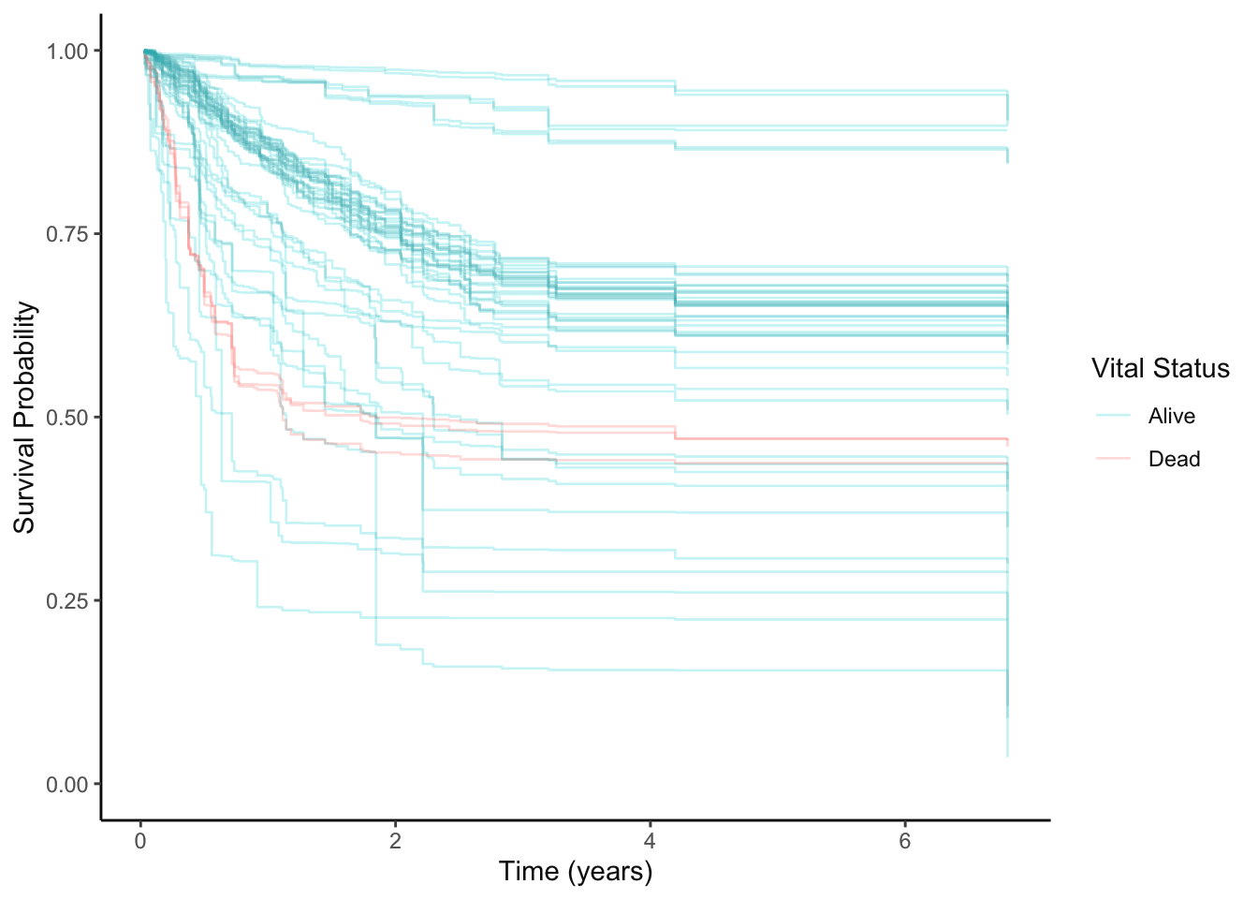
Random Forests Survival Models
Prediction Accuracy: 85-90% (~10-15% Error)
Patient-Specific Survival Curves
Train Data (75%) Test Data (25%)
Summary | Experiments and Evaluation | Timeline
Notes:
https://medium.com/@analyttica/what-is-bayesian-information-criterion-bic-b3396a894be6

Slide 32

Random Forests Survival Models
Prediction Accuracy: 85-90% (~10-15% Error)
Patient-Specific Survival Curves Grouped by HIV Status
Summary | Experiments and Evaluation | Timeline
Notes:
https://medium.com/@analyttica/what-is-bayesian-information-criterion-bic-b3396a894be6

Slide 33
Timeline Status - Done!
✔️
✔️
✔️
✔️
✔️
Data Wrangling and Management
Data Analysis
I, II
Prediction and Validation
Data Visualization
Presentation, Report, and Publication in IJROBP
Weeks 1 & 2 | Weeks 3 & 4 | Weeks 5 & 6 | Weeks 7 & 8 | Weeks 9 & 10
Summary | Data Analysis | Timeline

